Slide 1
Chapter 10
Understanding Work Teams
Dr. Mohsin Uddin
Department of Accounting
Faculty of Economics and Administrative Sciences
Ishik University, Erbil

Slide 2
Learning Objectives:
Contrast groups and teams, and analyze the growing popularity of using teams in organizations.
Compare and contrast four types of teams.
Identify the characteristics of effective teams.
Show how organizations can create team players.
Decide when to use individuals instead of teams.
Show how the understanding of teams differs in a global context.

Slide 3
Team
A team is any group of people organized to work together interdependently and cooperatively to meet the needs of their customers by achieving a purpose and goals.
Team are crated for both long term and short term interaction

Slide 4
T- ogether
E-veryone
A-chieves
M-ore

Slide 5
Members operate with a high degree of TRUST
Accountability and interdependence.
Members share authority and RESPONSIBILITY for self management

Slide 6

Teams
Work Team –
  Generates positive interaction through coordinated effort; individual efforts result in a level of performance that is greater than the sum of those individual inputs.
Notes:
Groups and teams are not the same thing. A group is primarily there to share information and make decisions, no real joint effort is required. A team works in a more coordinated effort to achieve a goal.

Slide 7
Groups vs. Teams
Groups
  Strong leader
  Individual accountability
  Organizational purpose
  Individual work products
  Efficient meetings
  Delegates work
  Random and varied skills
Teams
  Shared leadership
  Individual and mutual accountability
  Specific team purpose
  Collective work products
  Open-ended meetings
  Does real work together
  Complementary skills

Slide 8
Difference between a group and a team
 | Group | Team
Leadership | One leader | Multiple leaders
Members | Independent | Interdependent
Process | Discuss - Decide - Delegate | Discuss - Decide - Do
Product of work | Individual | Collective
Focus | Individual goals | Collective goals

Slide 9
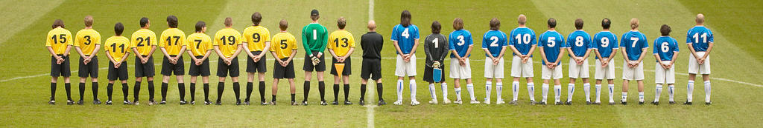
Why Are Teams So Popular?
Teams:
  Better utilize employee talents
  Are more flexible and responsive to change
  Democratize and motivate
Notes:
Over the last decade we have seen the use of teams grow exponentially in organizations. There are a number of reasons why this is true. Teams can enhance the use of employee talents and tend to be more flexible and responsive to change. Teams can help to keep employees engaged in their work and increase their participation in decision making, thus increasing their motivation. However, teams are not always effective, and so it is important to take a look at how to deploy teams effectively.

Slide 10
Comparing Work Groups and Work Teams
Notes:
Work groups and work teams differ on their goals, level of synergy, accountability and skills. Their function is different. Work groups share information where work teams work together for a collective performance. The synergy in groups is neutral where work teams have a positive synergy. Accountability can be individual in both but it is more often mutual in teams. The skills in a group will be varied where the skills on a team need to be complementary.

Slide 11
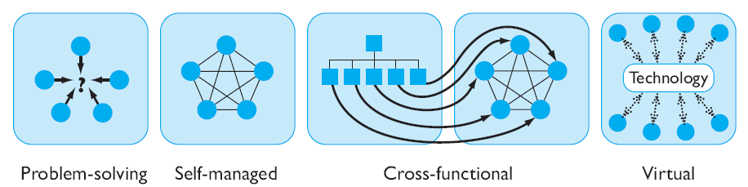
Four Types of Teams
Notes:
There are four main types of teams: problem-solving, self-managed, cross-functional and virtual.

Slide 12

Problem-Solving Teams
Members from the same department
Share ideas or suggest improvements
Given authority to individually implement any of their suggested actions
Notes:
Problem-solving teams are a very popular method used in many organizations. Typically this type of team meets for a few hours each week to solve a particular problem.

Slide 13

Self-Managed Work Teams
10-15 employees in highly-related jobs
Team takes on supervisory responsibilities:
  Work planning and scheduling
  Assigning tasks
  Operating decisions/actions
  Working with customers
May select and evaluate members
Effectiveness is situationally dependent
Notes:
Self-managed work teams is comprised of a group of people who do not have a manager and the group takes on the responsibilities of the supervisor.
The effectiveness of this group greatly depends on the situation and the goals of the group.

Slide 14
Cross-Functional Teams
Members from same level, but diverse areas within and between organizations
Exchange information
Develop new ideas and solve problems
Coordinate complex projects
Development may be time-consuming due to complexity and diversity
Notes:
Cross-functional teams gather workers from many different work areas to come together to accomplish a task that needs to utilize multiple perspectives.
This type of group is good at developing new ideas and solving problems or coordinating complex projects. Given that their tasks are normally complex and diverse it may take some time for the group to develop into an effective and productive team.

Slide 15

Virtual Teams
Computer technology ties dispersed team together
Special challenges:
  Less social rapport
  More task-oriented
  Members less satisfied
Notes:
Virtual teams are increasing in their use. This type of team uses computer technology to bring people together to achieve a common goal. Typically these types of teams get right to work with little socializing, but need to overcome time and space constraints to accomplish the task. In order to be effective, virtual teams need to find ways to establish trust among the members, have close monitoring and results need to be publicized.

Slide 16
Stages in Team Building
Forming
Storming
Norming
Performing
Notes:
As the team matures, members gradually learn to cope with each other and the pressures that they face. As a result, the team goes through the fairly predictable stages noted on the slide.

Slide 17
Stage 1: FORMING
The Team
defines the problem
agrees on goals and formulates strategies for tackling the tasks
determines the challenges and identifies information needed
Individuals take on certain roles
develops trust and communication
Notes:
To help the students adapt to their team, it might be wise to have them to simple activities to build trust and establish communication between the members. However, in the context of the computational science project many of the forming actions are undertaken as the team determines what their project topic will be and narrows the focus to reach their project goal. Teachers can help students as they "form" their teams by making sure that they understand the process they will go through to get their topic.
You may want to include some activities to illustrate trust and/or communication skills in a team.

Slide 18
Stage 2: STORMING
During the Storming stage team members:
  realize that the task is more difficult than they imagined
  have variations in attitude about chances of success
  may be resistant to the task
  have poor collaboration
Notes:
This is probably the most difficult stage for the team. They may be floundering trying to find a project topic that is narrow enough to study or a mentor to help them. They begin to realize that this project is different than other ones that they have done in the past. Teachers can help students through this stage by encouraging members to use their individual skills and assume more responsibilities.
Understanding how personality types interact can ease some of the tensions in the storming stage.

Slide 19
Storming Diagnosis
Do we have common goals and objectives?
Do we agree on roles and responsibilities?
Do our task, communication, and decision systems work?
Do we have adequate interpersonal skills?
Notes:
As a teacher, you can help your students when they are in the “storming” stage, by focusing their attention on the questions above. The students may want to answer the first question both in general terms and more specifically, in conjunction with their project goals.

Slide 20
Stage 3: NORMING
During this stage members accept:
  their team
  team rules and procedures
  their roles in the team
  the individuality of fellow members
Team members realize that they are not going to crash-and-burn and start helping each other.
Notes:
During this stage, team members begin to work out their differences and now have more time and energy to spend on their work. Thus they are able to start making significant progress.
In the context of the computational science project, the students have probably found a mentor who is helping them and have narrowed their project focus.

Slide 21

Key Components of Effective Teams
Context
Composition
Process
Notes:
The four key components of effective teams are context, composition, and process variables. Next we will look at each one of these components individually.

Slide 22
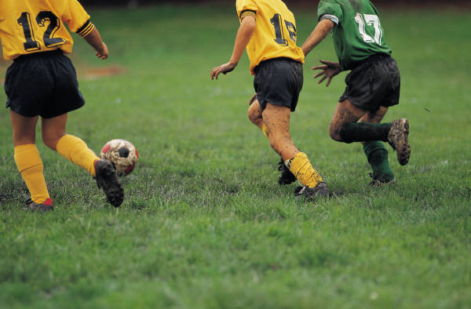
Contextual Components
Presence of adequate resources
Effective leadership and structure
Climate of trust in the team
Performance evaluation and reward system that reflects team contributions
Notes:
Understanding the context is important for teams to be effective. The team needs the right resources to do the job well. They also need effective leadership and structure to facilitate a process that will help the team succeed. It is important that teams fit together so they can successfully utilize the individual skills present in the group. Trust is also an important aspect of teams and essential for group cohesiveness as we have seen previously. Finally, the reward system needs to be equitable and based on team contributions.

Slide 23

Team Composition Components
Abilities of members
  Technical expertise
  Problem-solving
  Interpersonal
Personality
  Careful and open-minded
Distribution of Roles
Diversity
Size of teams
Member preferences
Notes:
A manager must pay close attention to how they put a team together to assure group cohesiveness and effectiveness. Each member should be selected based on the type of skills and abilities needed to accomplish the task at hand. However, abilities are not the only characteristic that managers need to pay attention to; personality is also important so that the team can bond and form trust.
In addition, the manager must be sure he assigns the right people to fill the roles needed, but still maintain adequate diversity so that idea generation still occurs. The manager must also pay attention to the size of the team and that the members want to be on the team and enjoy teamwork.

Slide 24

Process Components
Common plan and purpose
Specific goals
Team efficacy
Common mental models
Low levels of conflict
Notes:
Group’s processes can have a big impact on their effectiveness. In the process, groups must have a strong commitment to a common purpose that provides direction but yet incorporates reflexivity where it can adjust plan if needed. The goals of the team must be set up so they are specific, measurable, realistic yet challenging in order to keep the team members engaged.
The team must believe they can succeed and have a mental map of how to get the work done to assist in the process of accomplishing their task.
Finally, the group must navigate through conflict and social loafing to encourage a healthy and effective group.

Slide 25
Turning Individuals Into Team Players
Selection –
  Need employees who have the interpersonal as well as technical skills
Training –
  Workshops on problem-solving, communications, negotiation, conflict-management and coaching skills
Rewards –
  Encourage cooperative efforts rather than individual ones
Notes:
Not all employees are team players. In the US we tend to have more of an individualistic culture, and it is not always possible to turn everyone into a team player. When formulating teams it is important to carefully select the right employees who are more attuned to team work. It is also possible to train people on how to be good team members. Finally, if managers carefully craft a reward system to encourage cooperative efforts rather competitive ones they can encourage team work. However, it is still important to recognize individual contributions and avoid social loafing.

Slide 26
Implications for Managers
Common characteristics of effective teams:
  Have adequate resources, effective leadership, a climate of trust, and suitable reward system
  Composed of individuals with technical and interpersonal skills
  Work provides freedom, independence and opportunity to use skills
  Members are committed to a common purpose
Notes:
There are a number of common characteristics of effective teams such as a need for trust, smaller in size, a chance to contribute, significant tasks and a team who believes in itself.
Managers do need to modify the environment to help the team succeed and pay careful attention to the make-up of the team members to ensure success.

Slide 27
Keep in Mind…
Proper selection of members increases likelihood of effective teams
Team should be constructed based on ability, skill, and applicable member traits given the situation
Non-personal conflicts can lead to better team decisions
Notes:
If a team can properly select its members it will be more effective. This selection should be based on ability, skill and applicable traits based on the situation.
If non-personal conflicts can be fostered it may lead to better team decisions.

Slide 28
Summary
Contrasted groups and teams and analyzed the growing popularity of using teams in organizations.
Compared and contrasted four types of teams.
Identified the characteristics of effective teams.
Showed how organizations could create team players.
Decided when to use individuals instead of teams.
Showed how the understanding of teams differed in a global context.

