Slide 1
Time Management and Procrastination
Karwan H. Sherwani
Academic Life Skills I

Slide 2
Time Management Means:
The ability to use time productively and efficiently, especially for life, work, business, and school.

Slide 3
Importance of Time Management
“Remember that time is money”
Ben Franklin, 1748
Advice to a young tradesman

Slide 4
Importance of Time Management Cont..
Students who have difficulty managing their time, have difficulty managing their department courses.
A study of successful students of sophomore and time management.
Bad time management = Stress.
Time famine.

Slide 5
The concept of Time Management Implementation
Time management should not be viewed only as university success strategy, but also as a life management and life success skill.
The more you are in control of your time, you become more satisfied and happier with your life.

Slide 6
Signs of Bad Time Management
Messy desk and cluttered (or no) files
Can’t find things
Miss appointments, need to reschedule them late and/or unprepared for meetings
Volunteer to do things other people should do
Tired/unable to concentrate

Slide 7
Strategies for Time Management
Analyze become more aware about how it’s spent.
To do this, you conduct a time analysis by breaking down and track your time

Slide 8
Exercise,
What is your greatest time waster?
What to do to stop or eliminate it?

Slide 9
Itemize, identify which specific tasks you need to accomplish and when you need to accomplish them.
A planner. To list all the assignments, duties, commitments. To keep track of what you have to do and when you have to do it.
Modern Techniques:
Wunderlist app. *
Google Tasks
Get things done
Etc.

Slide 10
Prioritize, Rank your tasks in order of their Importance.
determine the order in which you will do them.
Two criteria of judgment to determine the priorities:
Urgency: tasks that are closest to their deadlines needs to take priority.
Gravity: Tasks that carry high importance, or mark, needs to receive highest priority.

Slide 11
Final tips for TM
Humans are creatures of habits, regular routine help us organize and control our life. Doing things by design, rather than leaving them to chance or accident

Slide 12
Procrastination
Derives from two roots: Pro (Forward) + Crastinus (Tomorrow)
Procrastinators use
“Why do today what can be put off until tomorrow?”
Instead of
“Why put off to tomorrow what can be done today”

Slide 13
Wrong myth about Procrastination
I work better under pressure.
Being under pressure, you may only focus on doing the assignment, or duty fast, but not on the quality of the duty.
Studying in advance is a waste of time because you will forget it all by the test time.
Usually results in lost sleep, anxiety due to lack of sleep. Rapid Eye Movement (REM). They experience higher rate of insomnia, stomach ache, colds and flu + Family Emergency.

Slide 14
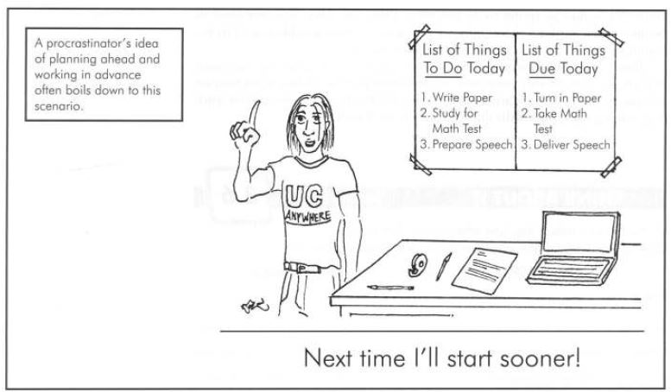

Slide 15
Psychological causes of Procrastination

