Slide 1
Introduction to Gender
Mohsin Uddin

Slide 2
Week | Topic
1 | Introduction to Gender
2 | Gender and Family
3 | Gender and Education
4 | Gender and Economy
5 | Gender Inequality in Labor Market
6 | Midterm Exam
7 | Gender Based Violence in Family
8 | Encountering Methods in Feminist Research
9 | Health Problems Associated with Women
10 | Gender and Electronic Media
11 | Gender Analysis Tools
12 | Gender Analysis in Various Contexts
13 | Women development: International initiatives
14 | Final Exam

Slide 3
COURSE EVALUATION CRITERIA
Method | Quantity |  | Percentage (%)
Participation | 1 |  | 10
Quiz | 1 |  | 5
Homework | 1 |  | 10
Midterm Exam(s) | 1 |  | 20
Presentation | 1 |  | 10
Field visit | 1 |  | 5
Final Exam | 1 |  | 40
Total |  |  | 100

Slide 4
Gender Primer Objectives
Understand the difference between gender and sex
Consider how gender roles impact participation
Appreciate diversity among women
Identify discrimination and how to address it
Notes:
SLIDE CONTENT: The objectives for this session are to:
Understand the difference between gender and sex
Consider how traditional gender roles impact women’s political participation and how these roles can be changed
Appreciate the diversity among women and the issues they prioritize
Identify discrimination in its many forms and how to address it
TRAINER NOTE: Provide an overview of the session’s objectives so that participants understand its purpose and have realistic expectations about what to expect. You may also wish to ask participants what expectations they have for the session. What do they hope to get out of it? You can then relate their expectations to the objectives and suggest how unrelated expectations might be met in other ways.

Slide 5
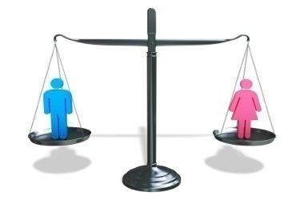
Gender Primer Topics
Sex and gender
Gender roles
Diversity among women
Women's issues
Identifying discrimination
Notes:
SLIDE CONTENT: The topics we will cover today include:
Sex and gender
Gender roles
Diversity among women
Women's issues
Identifying discrimination in its many forms
TRAINER NOTE: Give the participants a brief overview of the topics to be covered so they have a sense of where you are heading in the presentation. Summarize the main concepts that will be addressed.

Slide 6
EXERCISE: ROLES AND RESPONSIBILITIES
Brainstorm:
What do men do in your society?
What do women do in your society?
Only list activities, not professions or traits
Notes:
SLIDE CONTENT: Let’s do a brief exercise that will get us thinking about what men and women typically do in your community.
TRAINER NOTE: The point of this exercise is to help participants to understand the differences between sex and gender by considering activities that are traditionally done by men and women in their society. It is also meant to help participants realize that gender roles are not fixed - that they can change and that they vary from place to place. By the time you define sex and gender in the following slides, your participants should already have a good sense of the difference.
EXERCISE: Roles and Responsibilities
Please see the Trainer’s Guide for complete instructions on how to facilitate this activity.

Slide 7
DEFINITION: SEX
Biological
Classification based on reproductive organs and functions
Notes:
SLIDE CONTENT: The exercise we just completed has likely given you a good sense of the difference between sex and gender, but let’s provide definitions for both terms to make sure we have a common understanding.
Sex refers to the biologically determined physical differences between men and women that are universal. Sex is the property or quality by which organisms are classified as female or male on the basis of their reproductive organs and functions.
TRAINER NOTE: You can ask participants to refer back to a few of the examples of activities that men and women do that are related to their sex (having babies, breast-feeding, etc.)

Slide 8
DEFINITION: GENDER
Socially determined/constructed
Perceptions and expectations
“Acceptable” roles and attitudes
Learned behaviours
Changes over time
Varies by culture, ethnicity, religion etc.
Notes:
SLIDE CONTENT: Gender refers to the socially determined differences between women and men; these are learned, changeable over time and have wide variations both within and between cultures. Gender is related to how we are perceived and expected to think and act as women and men, based on how society is organized rather than biological differences. People are born female or male, but learn to be girls and boys who grow into women and men based on the gender norms in prevalent in their society. They are taught the ‘appropriate’ behaviour and attitudes, roles and activities and how they should relate to other people. This learned behaviour is what makes up gender identity and determines gender roles.
While only women can give birth (biologically determined), biology does not determine who will raise the children (socially determined).
Gender is a complex concept and is shaped by social, cultural, economic and political contexts in a given country. It may differ from region to region within countries. Gender differences can also vary depending on race, ethnicity, religion, age and marital status. For example, the gender roles “assigned” to a wealthy married Protestant woman living in the capital city of Ireland may be quite different than those assigned to a poor unmarried Catholic woman living in a village in the same country.

Slide 9
Other Key Terms
Gender equality
Gender equity
Gender discrimination
Constructive men’s engagement
Other terms?
Notes:
SLIDE CONTENT: Now that we understand the difference between sex and gender, there are a few other key terms to define so that we share a common understanding throughout our discussions:
Gender equality
Gender equity
Gender discrimination
Constructive men’s engagement
TRAINER NOTE: Ask the participants to define the terms first and then decide on a common definition based on their responses and the definitions included in the Trainer’s Guide. What do these terms mean in the context of the lives and work of the participants?
You might also ask them to suggest other terms relating to gender that they think need to be defined at the onset. You should let them know that they are welcome to stop and ask for clarification at any point during the session if there is a term with which they are unfamiliar or one which they believe requires further discussion.
For complete definitions of each term, see the Trainer’s Guide.

Slide 10
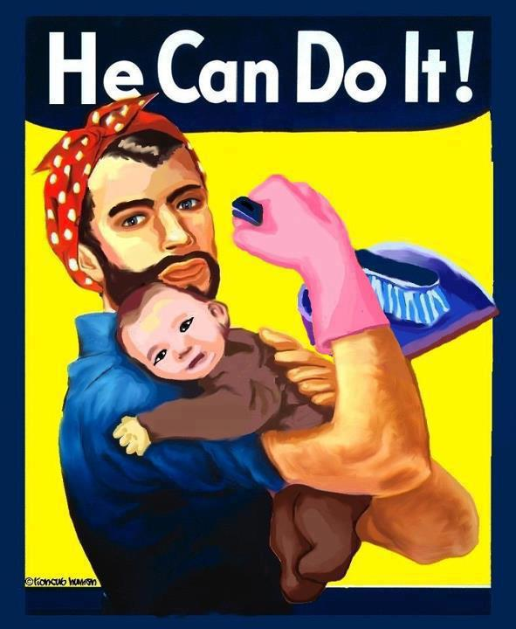
EXERCISE: SEX OR GENDER?
Image: Tulva
Notes:
SLIDE CONTENT: Before we move on, let’s do one more exercise to solidify our understanding of the difference between sex and gender.
TRAINER NOTE: If your participants are more advanced and you don’t feel that they need an additional activity to reinforce what they have learned about sex and gender, skip the quiz.
EXERCISE: Distribute the Gender Quiz. Read each question out loud and ask for volunteers to provide the answer. If you have more time, you can ask each participant to take five minutes to complete the quiz individually and then go over the answers as a group.
HANDOUT 1: Gender Quiz

Slide 11
GENDER ROLES
Ancient Egypt:
Men did weaving
Women inherited property
Study of 224 cultures
5: men did the cooking
36: women built houses
Notes:
SLIDE CONTENT: Let’s take a historical perspective. In Ancient Egypt, men did the weaving and women inherited property. This is the opposite of what we would expect. In a study of 224 cultures, men did the cooking in five cultures and women built houses in 36 of them. Again, this runs counter to what we generally expect men and women to do, reinforcing the concept that gender roles vary and change.
But how do they change? What if the roles that have been assigned to you are holding you back from achieving equality? The World Bank’s Gender Strategy Paper notes that “because the religious or cultural traditions that define and justify the distinct roles and expected behaviors of males and females are strongly cherished and socially enforced, change in gender systems often is contested. In some countries, there are groups which seek to impose more stringent divisions between males and females than currently exist, while feminist movements seek to reduce or eradicate these divisions.”
Gender roles changed considerably in the United States during World War II. Since many men were overseas fighting, women were encouraged to take their factory jobs. When the war ended, women were expected to return to being housewives but many wished to continue working outside the home.
TRAINER NOTE: Remind participants that gender roles vary from place to place and change over time. Ask participants how gender roles have changed in their countries. What gender roles were their grandmothers expected to fill? Their mothers? How is it different for them? For their daughters? How did these changes come about? Did things change out of necessity or because a group of people pushed for changes?

Slide 12
GENDER SENSITISATION -Definition
Gender
psychological term
our awareness and reaction to biological sex
determined by biological, psychological and sociological factors
Masculine and feminine are psychological terms which refer to a person's gender
Sex
biological term
functional differences between males and females and their reproductive potential
determined by genes
male and female are biological terms

Slide 13
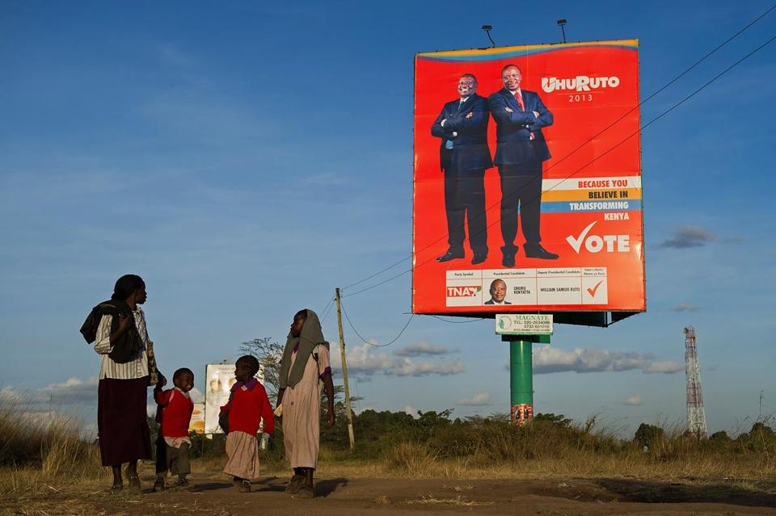
GENDER ROLES AND POLITICS
Gender roles
Men = political leaders
Women = followers
Photo: AFP/Getty Images
Notes:
SLIDE CONTENT: Based on all we’ve discussed, let’s turn to an important question. Does politics belong in the “sex” or the “gender” category? While political leaders are often men, women are certainly biologically capable of being successful politicians. However, gender roles in most cultures suggest that men are leaders and that politics is a male domain. As more women leaders emerge and challenge these assumptions, gender roles will slowly change. The more Hillary Clintons, Michelle Bachelets, Angela Merkels, Ellen Johnson Sirleafs, Helen Clarks, and Corazon Aquinos that we have, the more women – and men – will see that women can and should assume positions of political leadership.
TRAINER NOTE: Ask participants to name some of the women political leaders in their country who have challenged traditional gender roles. What is the secret of their success? What lessons can they teach other women who wish to be leaders?

Slide 14
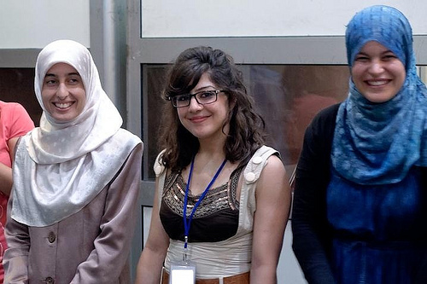
WOMEN ARE NOT THE SAME
Other differences:
Age
Ethnicity
Religion
Education
Language
Class
Disabilities
Photo: Angela Short, NDI
Notes:
SLIDE CONTENT: Let’s go back to the concept of sex for a moment. While we women share characteristics related to our sex – we have the same reproductive organs – we are not all the same just because we are women. Women are not a monolithic group. We are not just defined by our sex. We are also defined by a range of other characteristics such as:
Age
Ethnicity
Religion
Education
Language
Class
Disabilities
TRAINER NOTE: Ask participants if there are other characteristics that distinguish women from one another. What other factors determine who we are as individuals?

Slide 15
EXERCISE: WHOSE ISSUE?
Issue | Men | Women | Both
Controlling sales of guns
Providing free pre-natal care
Criminalizing gender-based violence
Supporting development of small businesses
Notes:
SLIDE CONTENT: Let’s do a quick exercise to get us thinking about issues that are of concern to men and women.
TRAINER NOTE: The point of this exercise is to help participants understand that while some issues may seem to be more closely associated with one sex than another, in reality, ALL issues have an impact on men and women, whether directly or indirectly.
EXERCISE: Whose issue?
Read the issues listed on the slide out loud to participants.
Start with the first issue and ask participants whether they think it is a men’s issue, a women’s issue, or one that concerns both men and women. Have participants raise their hands to vote – only one vote per issue – and write down their choices on a flipchart or enter into directly into the slide. Have participants “vote” on the remaining three issues.
After the voting has concluded, go back to the first issue and ask someone who identified it as a men’s issue to explain why they feel that this is the case. If someone suggested that it is a women’s issue, have her explain why. If anyone felt that it was an issue that concerns both men and women, ask for her logic. Go over the other three issues in the same way.
Once you have completed the process, ask participants to reflect on the discussion. Have they concluded that ALL issues are of concern to both men and women? If not, ask additional questions that will help them to come to this conclusion. For example, while pre-natal care has no direct impact on men as they would never be in a position to receive it, it certainly has an impact on the health of their wives, mothers, and daughters. If pre-natal care is not available and a woman due to a complication with her pregnancy, the impact will be felt by the whole family – women AND men.

Slide 16
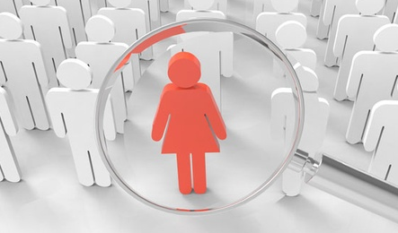
WOMEN’S ISSUES
What are they?
Traditional/stereotypical
“Soft” versus “hard” issues
ALL issues!
Notes:
SLIDE CONTENT: People tend to associate women with issues based on their traditional gender roles. For example, people assume that women will be interested in issues such as education and health because they have a direct impact on their children and other family members. These traditional or stereotypical issues are linked to a woman’s role as a caretaker. People often refer to these kinds of issues as “soft” issues. “Hard” issues, by contrast, are those that men tend to address such as finance and defense, areas linked to their gender roles as the “breadwinners” and defenders of the family. While it is true that women and men often gravitate to these respective issues, we need to remember that ALL issues are women’s issues. There isn’t an issue that doesn’t, in some way, touch on the lives of women and their families. And since women have unique perspectives, experiences and concerns, they should be involved in decisions, regardless of the issue.
TRAINER NOTE: Ask participants what issues are traditionally associated with men and women in their communities. Are there prominent women who are active on “hard” issues? Are there men who take a leadership role on “soft” issues? Have women been named as ministers to “hard” portfolios or have they been relegated to Social Welfare, Gender, Education, and Health ministries?

Slide 17
DISCRIMINATION
Overt vs. covert discrimination
Direct vs. indirect discrimination
Notes:
SLIDE CONTENT: We know that people tend to stereotype men and women based on their gender roles. This can lead to discrimination against women on the basis of their gender. Discrimination can take multiple forms. Overt discrimination is out in the open and easily identifiable. It is clear and apparent. For example, during the Apartheid era in South Africa, citizens of African descent were not allowed to vote. Covert discrimination is harder to detect and confirm. You may be told by a potential employer that they decided to hire someone more qualified when they really decided against hiring you because they didn’t think a woman could do the job.
Similarly, discrimination can be direct or indirect. Direct discrimination is clear, apparent and purposeful. With direct discrimination, there is a clear purpose to discriminate. For example, guardianship laws that treat the father as the legal guardian and allow mothers’ guardianship of children only in the absence of the father represent direct discrimination. Laws that grant different divorce rights to men and women or provide unequal or no inheritance to women and girls or prevent women from voting are all direct and purposeful in their discrimination.
Indirect discrimination does not have the express purpose of discriminating but has the same effect. For example, a public building may have elevators inside but steps only to get in the front entrance. This could indirectly discriminate persons with disabilities and require them to use the back entrance to the building since the front is not accessible. Laws may discriminate by treating people differently, placing different restrictions on them or excluding certain groups.

Slide 18
GENDER DISCRIMINATION
Examples from every day life
Notes:
SLIDE CONTENT: The United Nations Convention on the Elimination of all Forms of Discrimination against Women (CEDAW) defines discrimination against women as “any distinction, exclusion or restriction made on the basis of sex which has the effect or purpose of impairing or nullifying the recognition, enjoyment or exercise by women, irrespective of their marital status, on a basis of equality of men and women, of human rights and fundamental freedoms in the political, economic, social, cultural, civil or any other field.”
We’ve probably all experienced some form of gender discrimination at some point in our lives. Maybe you found out that your male colleague has a higher salary than you do even though you have the same level of education and experience. Perhaps your brother was encouraged to get a university education while you were encouraged to stay at home and get married.
TRAINER NOTE: Ask participants if they are comfortable sharing some of the examples of gender discrimination that they have experienced. Share your own if you are willing to do so. The point is to understand what discrimination looks like in our every day lives.

Slide 19
GENDER DISCRIMINATION IN POLITICS
Men rarely asked what impact politics will have on their families
Women politicians have to prove themselves
Women politicians get bad reputations
Comments on women’s clothing/hair
Notes:
SLIDE CONTENT: What does gender discrimination look like in the political arena?
Men are rarely asked what impact running for office will have on their families.
Women politicians have to prove themselves while their male colleagues are assumed to be competent, even if they aren’t.
Women in politics are seen to be women of ill repute since politics is a dirty business; male politicians are respected even when they engage in dirty practices.
Journalists often comment on what a woman politician is wearing, her attractiveness, her hair style or makeup. No one says anything about the suits her male colleagues are wearing.
Some of these things may seem relatively trivial and unimportant, but they are all signs of discrimination and are not acceptable.
TRAINER NOTE: Ask participants if they can think of other examples of discrimination in politics. What have they done to address this discrimination?

Slide 20
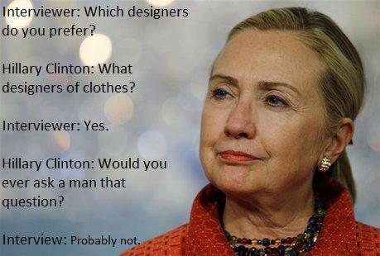
EXAMPLE: GENDER DISCRIMINATION IN POLITICS
Photo: Women’s Rights News
Notes:
SLIDE CONTENT: Here is a great example of gender discrimination in action. It’s also a great example of what to do when you are confronted with it.
Former US Secretary of State Hillary Clinton was once asked which clothing designers she preferred. She responded by asking the interviewer, “Would you ever ask a man that question?” Embarrassed and caught off guard, the interviewer responded, “Probably not” and that was the end of that line of inquiry.

Slide 21
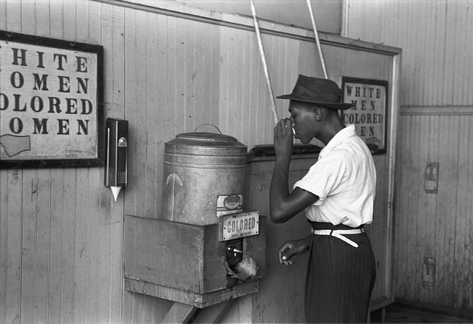
EXERCISE: BRAINSTORMING OTHER FORMS OF DISCRIMINATION
Photo: www.pixabay.com
Notes:
SLIDE CONTENT: Of course gender discrimination is not the only form of discrimination out there. What are some of the other forms you can think of?
EXERCISE: Brainstorming Other Forms of Discrimination - Lead participants through a brief brainstorming exercise. Ask them to provide examples of other forms of discrimination and write them on a flip chart.

Slide 22
OTHER FORMS OF DISCRIMINATION
Religion
Language
Sexual orientation
Ethnicity
Nationality
Political affiliation
Age
Disability
Pregnancy
Physical attributes
Notes:
SLIDE CONTENT: Other forms of discrimination include:
Religion
Language
Sexual orientation
Ethnicity
Nationality
Political affiliation
Age
Disability
Pregnancy
Physical attributes: weight, height
Many people face multiple and overlapping forms of discrimination. For example, the Roma people are generally subjected to high levels of discrimination in Europe. Imagine the challenges Roma women face. Or, consider women in an African country like Burkina Faso and the challenges she might face. Imagine the situation for a woman with a disability in that country.
TRAINER NOTE: Compare the responses that participants generated during their brainstorm with the list on this slide. Ask participants to provide examples of discrimination based on some of these characteristics. For example, in some countries, people may be overlooked for government positions because they are affiliated with the political opposition. A company may be reluctant to hire a pregnant woman knowing that she will take maternity leave soon after starting.

Slide 23
COSTS OF DISCRIMINATION
Gender inequalities:
reduce program effectiveness and waste resources
inhibit country’s growth and development
limit opportunities and potential
Notes:
SLIDE CONTENT: While some cases of discrimination may seem relatively innocent, all cases should be taken seriously. Why? Because discrimination and gender inequalities have a negative impact not just on individuals, but on the whole society. Discrimination comes at a high cost, including:
Gender inequalities reduce program effectiveness and waste resources (this is true in the case of both government programs and development programs).
Gender inequalities inhibit a country’s growth and development. Countries that don’t take advantage of the strengths and capabilities of ALL of their citizens – both men and women – are losing out on opportunities. Women are often an untapped resource.
Gender inequalities limit lifetime opportunities and individual potential for women and, by extension, their families.

Slide 24
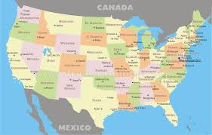
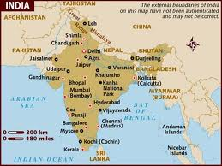
COSTS OF DISCRIMINATION
Loss of GDP in US:
Racial discrimination: 4%
Gender discrimination: 3%
Loss of GDP in India:
Gender discrimination: 4%
Notes:
SLIDE CONTENT: Researchers in the US and other countries have sought to measure the economic impact, the real cost, of discrimination. For example, in the US, it is estimated that racial discrimination results in a loss of gross domestic product of 4% while gender discrimination results in a loss of 3%. This means that if there was equality between the sexes and the races in the US, its economy would grow by an additional 7%!
A recent study in India noted that gender inequality, in this case, manifested in the low levels of female participation in the workforce, has had a significant and negative impact on the country’s economy. If women and men participated equally in the workforce, it is estimated that the economy would be boosted by billions of dollars. As a recent article notes, “Women's inequality may, in other words, have cost India's economy almost 4 percent of annual growth over the past 10 years.”
While it would be nice if everyone valued equality and was against discrimination because it is the right thing to do, some may only be swayed by these types of economic arguments.
TRAINER NOTE: For more information on the India case study, see the following article: http://www.theatlantic.com/international/archive/2013/03/the-huge-cost-of-indias-discrimination-against-women/274115/

Slide 25
TOOLS TO FIGHT BACK
Name it
Change it
Take legal action
Advocate for temporary special measures or other policies/legislation
Advocate for new laws
Ignore it…but it won’t go away
Notes:
SLIDE CONTENT: There are a number of different ways to fight discrimination and win. You may not succeed right away but at least you will continue to push for change, not just for yourself but for other women.
Name it: Sometimes just calling discrimination what it is can be effective such as in
the Hillary Clinton example earlier. Just by pointing out discrimination as it is taking place, the person that is committing it may become more self aware and may think twice before doing it again. If nothing else, you are making discrimination more visible and thus harder to ignore.
Change it: If the laws of your country are supportive, take legal action on a personal
level. Your legal victory or even defeat may inspire other women to confront discrimination. Your case could even change laws in your country for the better by challenging the legality/constitutionality of the status quo. You could also advocate for temporary special measures or other policies/legislation. For example, you could support the establishment of quotas in parliaments, political parties, executive branch positions or even in the private sector. You could advocate for the establishment of laws around issues such as domestic violence and sexual harassment that will help to change mind-sets. Laws that criminalize certain activities, assuming they are enforced, will eventually change mindsets about what is and isn’t acceptable.
You could also just ignore discrimination…but that won’t make it go away.
TRAINER NOTE: Ask participants how they have confronted discrimination in the past. What strategies have been successful? Which have not?

Slide 26
TOOLS TO FIGHT BACK
Engage men!
Men also affected – directly and indirectly
Gender inequality and discrimination impact society as a whole
Notes:
SLIDE CONTENT: Don’t forget to engage men in your efforts to confront discrimination and address gender inequality. While it may often seem like they are the problem – or at least are the adversaries – consider that men are also impacted by gender discrimination and inequality both directly and indirectly. Men may find it difficult to break into careers that are typically dominated by women. They may also feel limited by their typical gender roles. For example, many men have trouble expressing their emotions. Men aren’t supposed to cry. But by suppressing these emotions, the mental health of men can suffer.
Gender discrimination and inequality are issues that impact society as a whole. We learned earlier that there is good reason to believe that gender inequality slows economic growth. This is certainly a concern for men.
While it may be a little harder to convince men of the costs of gender discrimination and inequality and what they stand to gain by addressing them, it is possible and men are increasingly championing these issues. Identify potential allies, consider the arguments that will convince them, and enlist them in your efforts.
TRAINER NOTE: Ask participants if they can think of examples of men in their country who have championed gender equality. Why do they think these men have taken up the cause? How can more men be convinced to do so?

Slide 27
GENDER PRIMER REVIEW
Very little that women can’t do based on sex
Gender roles impact political participation… but can change
Women are a diverse group
ALL issues are women’s issues
Discrimination is costly… name it and change it!
Notes:
SLIDE CONTENT: Today we’ve discussed some of the key facts related to gender. We know that:
There is very little that women can’t do on the basis of their sex alone.
Gender roles can have a negative impact on women’s political participation but this can and should change.
Women are a diverse group and have different needs and interests.
ALL issues are women’s issues. There isn’t anything that doesn’t have an impact on women and their families.
Discrimination is costly and has a negative impact on individual women, but also on society as a whole. We need to draw attention to discrimination when we encounter it and work to change it.
Are there any questions?
TRAINER NOTE: Summarize the main points covered. Focus on areas of particular interest to the group or areas that raised a lot of questions during the workshop. Address any particular areas about which the group had questions and allow time for final questions, feedback, and evaluation of the workshop.
HANDOUT: Evaluation form

Slide 28
Gender Primer Objectives
Understand the difference between gender and sex
Consider how gender roles impact participation
Appreciate diversity among women
Identify discrimination and how to address it
Notes:
SLIDE CONTENT: The objectives for this session are to:
Understand the difference between gender and sex
Consider how traditional gender roles impact women’s political participation and how these roles can be changed
Appreciate the diversity among women and the issues they prioritize
Identify discrimination in its many forms and how to address it
TRAINER NOTE: Provide an overview of the session’s objectives so that participants understand its purpose and have realistic expectations about what to expect. You may also wish to ask participants what expectations they have for the session. What do they hope to get out of it? You can then relate their expectations to the objectives and suggest how unrelated expectations might be met in other ways.

Slide 29
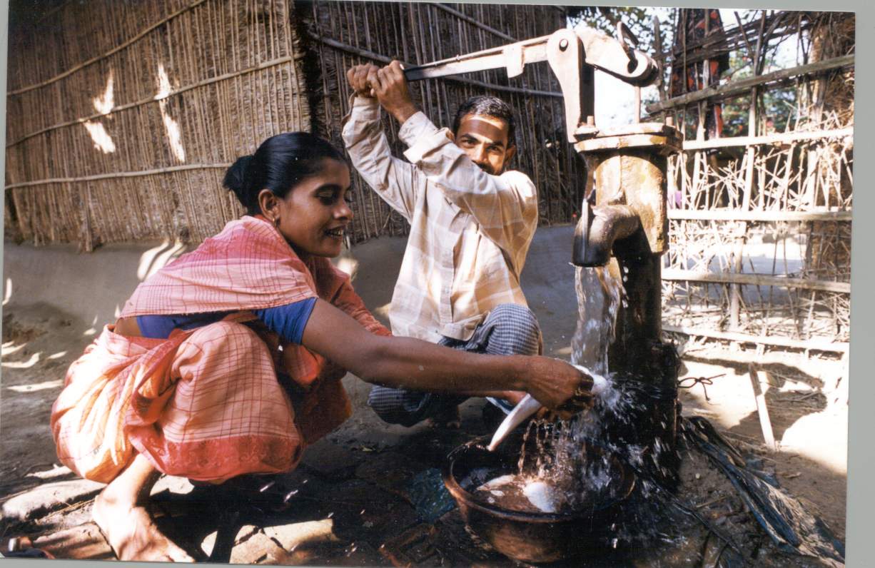
???
Let’s have a look…

Slide 30
Sex
Biological differences between men and women.
Not vary with race, caste, class, ethnicity, religion, and time.
Women’s ability to give birth, breast feed.
Gender
Social differences between men and women
Manifested in different roles, qualities and behaviors of women, men and society as a whole.
Vary with race, caste, class, ethnicity, religion, relation position, situations, age, time.
Vary with situations, the same person may behave differently in different contexts.
Notes:
30

Slide 31
Gender roles
Refers to socially differentiated roles of men and women
Gender roles can be changed easily through sensitization of women and men.
Productive Role
Reproductive role
Community Role

Slide 32
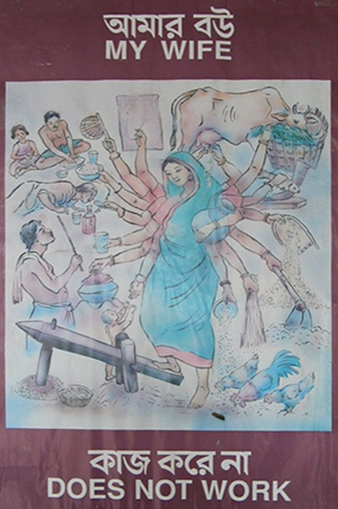
Gender roles
Women’s
Double Day
Triple Role

Slide 33
Gender Needs
Practical gender needs (PGN):
Related to immediate needs of living, such as food, drinking water, health care and medical support.
Strategic gender needs (SGN):
Related to gender divisions of labor, equal wages, resources and education, and women’s control over their bodies.
Necessary to encompass social and political reforms for ensuring power and control, legal rights, reduce domestic violence, .
These measures are seen as relatively long-term objectives.

Slide 34
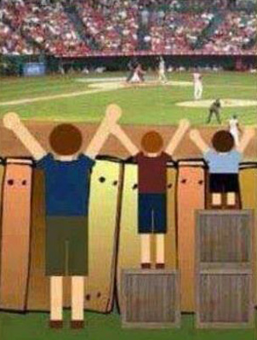
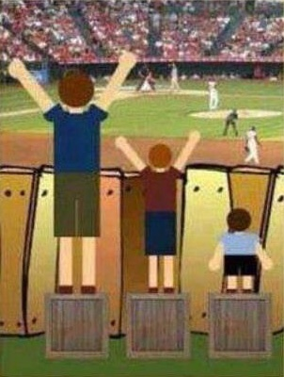
Gender Equality and Equity
Gender Equality VS
Gender Equity
Gender Equality
Gender Equity

Slide 35
Gender sensitization tools

Slide 36
Tool-1: Gender Equity Analysis
Education
Education
Education
Asset
Asset
Asset
Control
Control
Control
Right
Right
Right
Power
Power
Power
Inequity
Inequity
Equity

Slide 37
Tool-2: Access -Control Analysis
MEN
WOMEN
Access
Cows
Land
Control
Cows
Grass
Grass
Money
Feed
Milk
Money
Land
Feed
Milk
Asset
Cows
Grass
Money
Land
Feed
Milk
Control
Cows
Grass
Money
Land
Feed
Milk
Red = Low
Yellow = Moderate
Green = High

Slide 38
Access
Availability- can own Asset
Handiness- Able to use when required
Control
Authority/Autonomy- Right or permission or liberty to use the asset (Sell)
Decision making- power to make decisions within the household and community
Command- Access power to direct or regulate resource
ability to use effectively
Power- to influence or direct people’s behavior or the course of events.

Slide 39
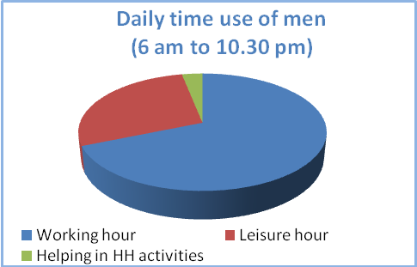
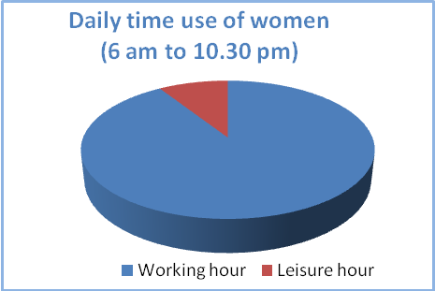
Tool-3: Time Meter Tool

Slide 40
Tool-4: Barrier Tree Analysis
Branches
Effect
Barrier
Stem
Root
Causes

Slide 41
Four Major Women Barriers
Workload
Control over asset, income
Institutions, ideology
Mobility

