Slide 1
Introduction to Economics II Chapter 2: Consumers, Producers, and the Efficiency of Markets

Slide 2
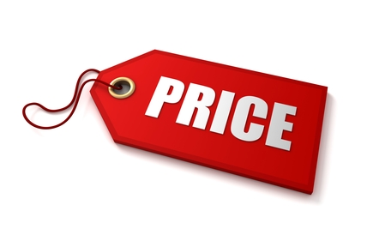
Are we happy with market prices?
Consumers: When consumers go to the butcher to buy meat for Nowruz trips, they may be disappointed that the price of meat is as high as it is.
Producers: At the same time, when butchers bring to market the meat (lamb and beef) they have, they probably wish the price of meat was even higher.

Slide 3
Are we happy with market prices?
These views are not surprising: Buyers always want to pay less, and sellers always want to be paid more. But is there a “right price” for meat from the standpoint of society as a whole?

Slide 4
Welfare Economics
In this chapter, we take up the topic of welfare economics, the study of how the allocation of resources affects economic well-being.
We begin by examining the benefits that buyers and sellers receive from engaging in market transactions. We then examine how society can make these benefits as large as possible.
This analysis leads to a profound conclusion: In any market, the equilibrium of supply and demand maximizes the total benefits received by all buyers and sellers combined.

Slide 5
Willingness to Pay the maximum amount that a buyer will pay for a good.
What’s the highest price you are willing to pay to buy a sunglasses?
$50.
What’s the highest price you are willing to pay to repair your car on the way while traveling out side the city?
$100

Slide 6
Willingness to Pay
Each buyer would be eager to buy the Elvis Presley album at a price less than his willingness to pay, and he would refuse to buy the album at a price greater than his willingness to pay.
At a price equal to his willingness to pay, the buyer would be indifferent about buying the good: If the price is exactly the same as the value he places on the album, he would be equally happy buying it or keeping his money.

Slide 7
Consumer Surplus
Consumer Surplus: the amount a buyer is willing to pay for a good minus the amount the buyer actually pays for it.
What’s the actual price you pay to buy a sunglasses from the market?
$30
What’s the actual price you pay to repair your car on the way while traveling out side the city?
$60

Slide 8
Consumer Surplus
Consumer Surplus: the amount a buyer is willing to pay for a good minus the amount the buyer actually pays for it.
Good or Service | Willingness to pay | Actual price | Consumer’s Surplus
Sunglasses | $50 | $30 | $20
Car Repair | $100 | $60 | $40

Slide 9
Using the Demand Curve to Measure Consumer Surplus
Consumer surplus is closely related to the demand curve for a product. To see how they are related, let’s continue our example and consider the demand curve for this rare Elvis Presley album. We begin by using the willingness to pay of the four possible buyers to find the market demand schedule for the album.

Slide 10
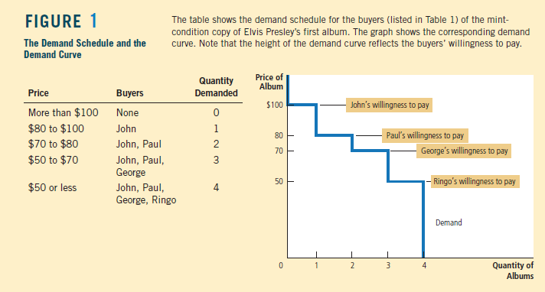

Slide 11
Because the demand curve reflects buyers’ willingness to pay, we can also use it to measure consumer surplus. Figure 2 uses the demand curve to compute consumer surplus in our two examples. In panel (a), the price is $80 (or slightly above) and the quantity demanded is 1. Note that the area above the price and below the demand curve equals $20. This amount is exactly the consumer surplus we computed earlier when only 1 album is sold.

Slide 12
Panel (b) of Figure 2 shows consumer surplus when the price is $70 (or slightly above). In this case, the area above the price and below the demand curve equals the total area of the two rectangles: John’s consumer surplus at this price is $30 and Paul’s is $10. This area equals a total of $40. Once again, this amount is the consumer surplus we computed earlier.
The area below the demand curve and above the price measures the consumer surplus in a market.

Slide 13
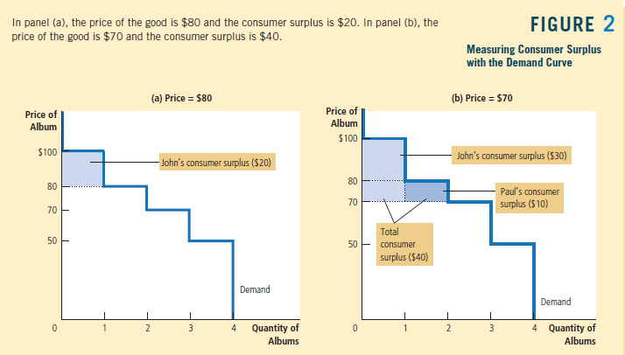

Slide 14
Why do we measure consumer surplus?
Imagine that you are a policymaker trying to design a good economic system.
Would you care about the amount of consumer surplus?
Consumer surplus is a good measure of economic wellbeing if policymakers want to respect the preferences of buyers.

Slide 15
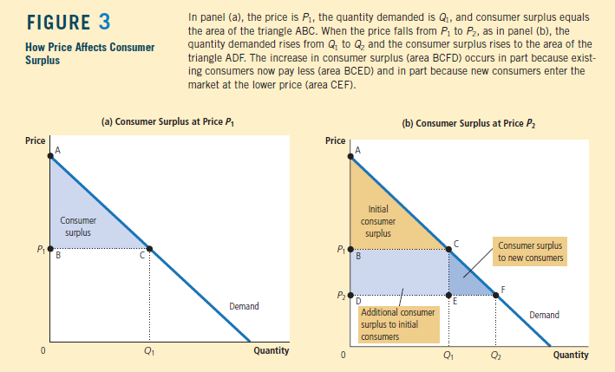

Slide 16
Cost and the Willingness to Sell
Cost the value of everything a seller must give up to produce a good.
What is your cost of copying the lecture slide for your friend?
$2
What is your cost of preparing a burger sandwich?
$3

Slide 17
Willingness to Sell
When you take bids from the painters, the price might start high, but it quickly falls as the painters compete for the job. Once Grandma has bid $600 (or slightly less), she is the sole remaining bidder. Grandma is happy to do the job for this price because her cost is only $500. Mary, Frida, and Georgia are unwilling to do the job for less than $600. Note that the job goes to the painter who can do the work at the lowest cost.

Slide 18
Producer Surplus the amount a seller is paid for a good minus the seller’s cost of providing it.
What is the actual price you receive for copying the lecture slides from your friend?
$4
What is the actual price you receive from selling a burger sandwich?
$7

Slide 19
Producer Surplus the amount a seller is paid for a good minus the seller’s cost of providing it.
Good or Service | Willingness to sell | Actual cost | Producer’s Surplus
Copy the lecture slides | $4 | $2 | $2
Burger Sandwich | $7 | $3 | $4

Slide 20
Using the Supply Curve to Measure Producer Surplus
Producer surplus is closely related to the supply curve.
The table in Figure 4 shows the supply schedule that corresponds to the costs in Table 2. If the price is below $500, none of the four painters is willing to do the job, so the quantity supplied is zero. If the price is between $500 and $600, only Grandma is willing to do the job, so the quantity supplied is 1. If the price is between $600 and $800, Grandma and Georgia are willing to do the job, so the quantity supplied is 2, and so on. Thus, the supply schedule is derived from the costs of the four painters.

Slide 21
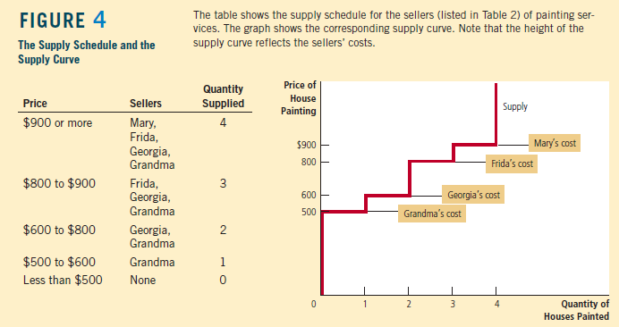

Slide 22
Figure 5 uses the supply curve to compute producer surplus in our two examples.
In panel (a), we assume that the price is $600 (or slightly less). In this case, the quantity supplied is 1. Note that the area below the price and above the supply curve equals $100. This amount is exactly the producer surplus we computed earlier for Grandma.

Slide 23
Panel (b) of Figure 5 shows producer surplus at a price of $800 (or slightly less). In this case, the area below the price and above the supply curve equals the total area of the two rectangles. This area equals $500, the producer surplus we computed earlier for Georgia and Grandma when two houses needed painting.
The area below the price and above the supply curve measures the producer surplus in a market.

Slide 24
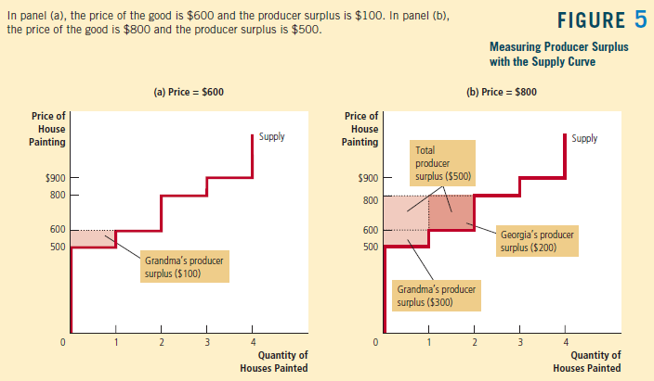

Slide 25
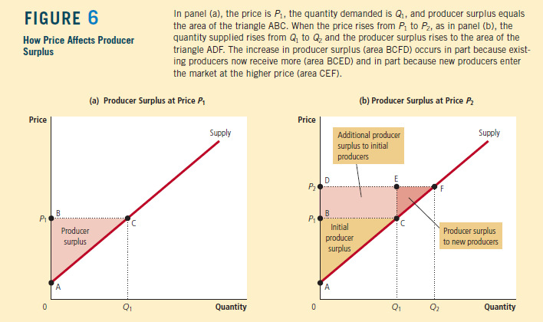

Slide 26
Figure 6 shows a typical upward-sloping supply curve that would arise in a market with many sellers. Although this supply curve differs in shape from the previous figure, we measure producer surplus in the same way: Producer surplus is the area below the price and above the supply curve.
In panel (a), the price is P1 and producer surplus is the area of triangle ABC.
Panel (b) shows what happens when the price rises from P1 to P2. Producer surplus now equals the area ADF.
This increase in producer surplus has two parts. First, those sellers who were already selling Q1 of the good at the lower price P1 are better off because they now get more for what they sell.
The increase in producer surplus for existing sellers equals the area of the rectangle BCED. Second, some new sellers enter the market because they are willing to produce the good at the higher price, resulting in an increase in the quantity supplied from Q1 to Q2. The producer surplus of these newcomers is the area of the triangle CEF.

Slide 27
Question Bank
What’s the difference between the price for consumers and the price for producers? Are they happy about prices?
What is the difference between the willingness to pay and consumer’s surplus?
Find the consumer’s surplus in this table.

Slide 28
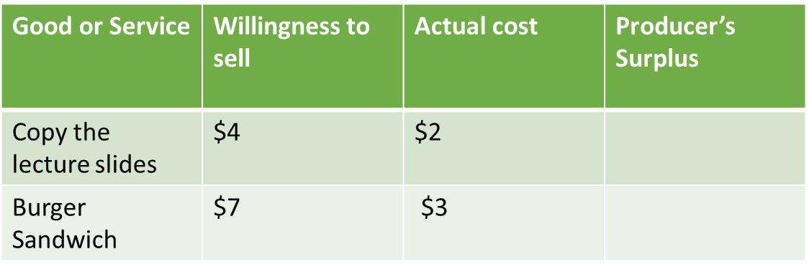
Question Bank
Find the producer’s surplus in the following table.
There will be a question about analyzing any figure or curve in slides of this chapter.

