Slide 1
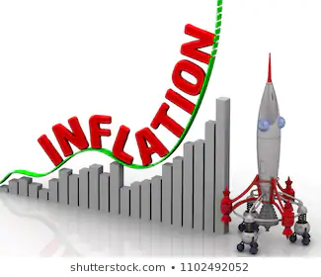
Macroeconomics
Inflation
HE EDUCATOR
Dr. Waqar Ahmad
Faculty of Administrative Sciences and Economics

Slide 2
Learning objective
Define Inflation
Identify the different degrees of inflation
Demand pull inflation
Cost push inflation
Factors affecting inflation

Slide 3
Inflation - Main Causes of Inflation
Inflation is a sustained rise in the general price level.
Inflation can come from both the demand and the supply-side of an economy

Slide 4
Inflation can arise from internal and external events
Some inflationary pressures direct from the domestic economy, for example the decisions of utility businesses providing electricity or gas or water on their tariffs for the year ahead, or the pricing strategies of the food retailers based on the strength of demand and competitive pressure in their markets.

Slide 5
A rise in the rate of VAT would also be a cause of increased domestic inflation in the short term because it increases a firm's production costs.
Inflation can also come from external sources, for example a sustained rise in the price of crude oil or other imported commodities, foodstuffs and beverages.
Fluctuations in the exchange rate can also affect inflation – for example a fall in the value of the pound against other currencies might cause higher import prices for items such as foodstuffs from Western Europe or technology supplies from the United States – which feeds through directly or indirectly into the consumer price index.

Slide 6
Measurement of Inflation
The main measure of Inflation in U.S is Consumer Price Index (CPI), complied by the Bureau of Labor Statistics (BLS).
Price of the most recent market basket in the particular year
Price of the most same market basket in the particular year in
CPI =
100

Slide 7
Measurement of Inflation
Current yr – Previous yr
Rate of Inflation =
100
Previous yr
The rate of inflation for a certain year (say 2005) is found by comparing, in percentage terms, that years index with the Index in the previous year. For example, the CPI was 195.3 in 2005, up from 188.9 in 2004. So the rate of inflation for 2005 in calculated as follows:
195.3 – 188.9
3.4%
Rate of Inflation =
100
188.9

Slide 8
Demand-pull inflation
Demand pull inflation occurs when aggregate demand is growing at an unsustainable rate leading to increased pressure on scarce resources and a positive output gap
When there is excess demand, producers can raise their prices and achieve bigger profit margins
Demand-pull inflation becomes a threat when an economy has experienced a boom with GDP rising faster than the long-run trend growth of potential GDP
Demand-pull inflation is likely when there is full employment of resources and SRAS is inelastic.

Slide 9
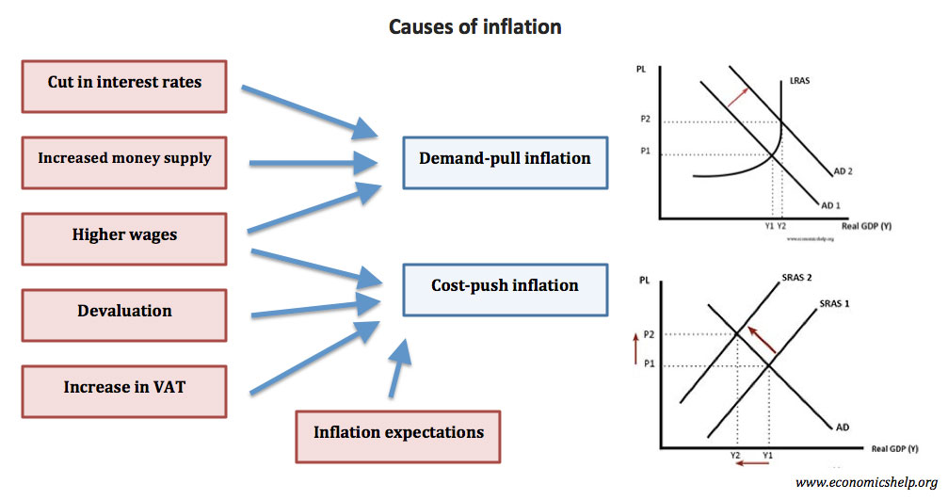

Slide 10
What are the main causes of Demand-Pull Inflation?
A depreciation of the exchange rate increases the price of imports and reduces the foreign price of a country's exports. If consumers buy fewer imports, while exports grow, AD in will rise – and there may be a multiplier effect on the level of demand and output.
Higher demand from a fiscal stimulus e.g. lower direct or indirect taxes or higher government spending. If direct taxes are reduced, consumers have more disposable income causing demand to rise. Higher government spending and increased borrowing creates extra demand in the circular flow.

Slide 11
Monetary stimulus to the economy: A fall in interest rates may stimulate too much demand – for example in raising demand for loans or in leading to house price inflation. Monetarist economists believe that inflation is caused by “too much money chasing too few goods" and that governments can lose control of inflation if they allow the financial system to expand the money supply too quickly.
Fast growth in other countries – providing a boost to UK exports overseas. Export sales provide an extra flow of income and spending into the UK circular flow – so what is happening to the economic cycles of other countries definitely affects the UK

Slide 13
Cost-push inflation
Cost-push inflation occurs when firms respond to rising costs by increasing prices in order to protect their profit margins.
There are many reasons why costs might rise:
Component costs: e.g. an increase in the prices of raw materials and other components. This might be because of a rise in commodity prices such as oil, copper and agricultural products used in food processing. A recent example has been a surge in the world price of wheat.
Rising labour costs - caused by wage increases, which are greater than improvements in productivity. Wage costs often rise when unemployment is low because skilled workers become scarce and this can drive pay levels higher. Wages might increase when people expect higher inflation so they ask for more pay in order to protect their real incomes. Trade unions may use their bargaining power to bid for and achieve increasing wages, this could be a cause of cost-push inflation

Slide 14
Expectations of inflation are important in shaping what actually happens to inflation. When people see prices are rising for everyday items they get concerned about the effects of inflation on their real standard of living. One of the dangers of a pick-up in inflation is what the Bank of England calls “second-round effects" i.e. an initial rise in prices triggers a burst of higher pay claims as workers look to protect their way of life. This is also known as a “wage-price effect"
Higher indirect taxes – for example a rise in the duty on alcohol, fuels and cigarettes, or a rise in Value Added Tax. Depending on the price elasticity of demand and supply for their products, suppliers may choose to pass on the burden of the tax onto consumers.
A fall in the exchange rate – this can cause cost push inflation because it leads to an increase in the prices of imported products such as essential raw materials, components and finished products
Monopoly employers/profit-push inflation – where dominants firms in a market use their market power (at whatever level of demand) to increase prices well above costs

Slide 16
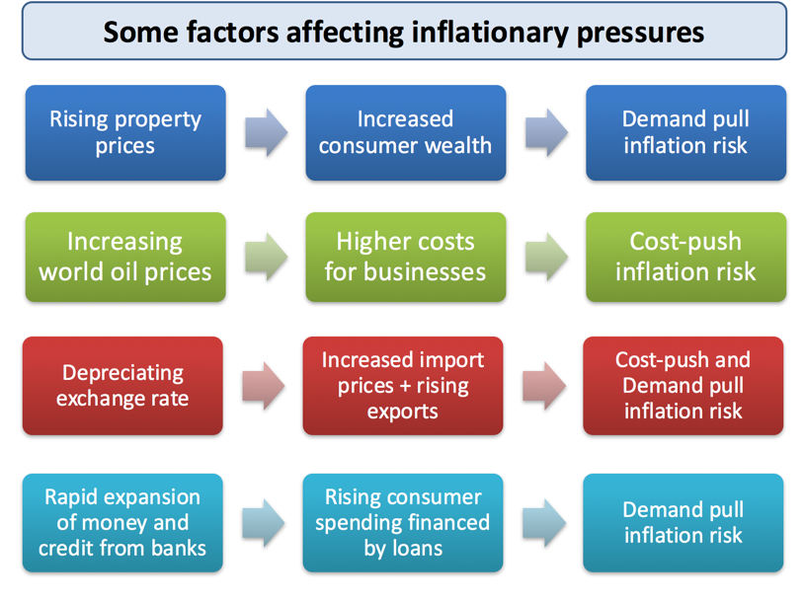
A summary of some of the main inflationary forces in an economy

Slide 17
Cause of Inflation

Slide 18
Effect of Inflation

Slide 19
Thank you

